Slide 1
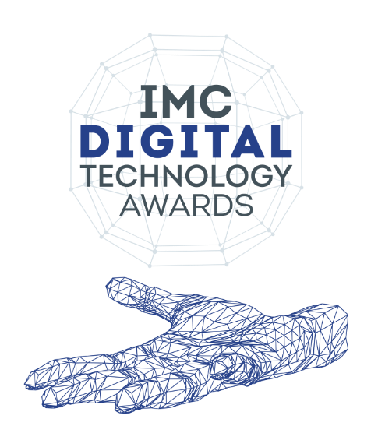
IMC Digital Technology Awards 2023
Guidelines and Instructions
Link : www.imc-itawards.in

Slide 2
The purpose of these awards is to recognise and reward superior Digital & IT accomplishments across the spectrum IMC rewards all - the start-ups, IT companies, End-User companies, Government departments and individual technology leaders – for technological solutions, applications, and improvements that have transformed businesses and made a difference.
PURPOSE

Slide 3
The applicants can apply in any of the following Categories
The awards are divided into three categories. Please select the relevant category while applying
Category – 1: Smart Tech companies
These are companies which use new-age digital business models or digital technologies in their operations and such use contributes to more than 75% of their annual revenues. This is further sub-divided based on turnover and type of companies (bifurcation in next slide)
Category – 2: Organisations and Govt. departments embracing Digital Transformation
These are firms, Govt. sectors that have brought about digital transformation in their businesses and operations. This category is further sub-divided into three sectors:
manufacturing,
services and
Govt. & PSUs.
Each sector will have one award each for MSME and non-MSME categories
Category – 3: Individual Technology Leaders who have made a significant difference with their vision
Individual Digital Transformation leaders CDOs / CIOs / CTOs with impact on digital business models and new products or services
Individual CDOs / CIOs / CTOs with impact on IT, Security & digital implementation
Best woman IT / Digital leader award

Slide 4
Category 1 is divided in 4 sectionS
Category 1A | Category 1B | Category 1C | Category 1D
Nascent “Born Digital” Startups | Mid-level solution / product oriented Digital companies | Pure Play Digital / online companies | Established IT and Technology Service companies
You are a new startup Co with a new / disruptive idea and have set up a digital business after 1-Jan-2020 and with annual (2022) revenues between Rs 1– 10 crore* | You are company using smart digital tech in your product or services Annual (2022) revenues between Rs 10-100 crore* | Companies having 2022 revenues more than 100 crore* primarily from new digital / online /virtual business models, disrupting legacy businesses | Mid / Large scale technology solution companies providing products / services that help transform other businesses digitally across sectors
* More than 75% of the turnover should be from digital / online technologies

Slide 5
Category 2, 3 is summarised below
Category -2 | 2a. Manufacturing Sector | 2b. Services Sector | 2c. Govt Dept / PSU
MSME | At least 1 award | At least 1 award | At least 1 award
Non-MSME | At least 1 award | At least 1 award | At least 1 award
* In case of exceptional situations, the jury may decide to award more than one in a sub-category above
Category -3 | Best CDO / Digital Business Leader | Best CIO / CTO | Best Woman Technology Leader
One award in each of the sub-categories shown | Individuals who have made significant contribution to digital business or digital products | Individuals who contributed to their IT departments on consistent basis and harnessed technology significantly | Women digital / IT leaders who have contributed with impact to the scale up in their departments

Slide 6
Rules for 2023 Awards
Award will be given to entities on the basis of best implementation of a project, or practice using digital / IT tools and processes for Categories-1,2
For category-2, the awards will be given in two sub-categories : MSME and non-MSME companies. Firms will need to upload their 2022 MSME Udyam certificates
For category-3, individuals can be self-nominated, or others could nominate leaders who have made a significant long term impact with their digital / IT leadership & vision
To be uploaded on www.imc-itawards.in or sent to imc-itawards@imcnet.org
Jury decision will be final and binding
IMC will be using the data submitted in the nomination for aggregate analysis and research which would help identify digital trends and best practices for the greater good of the industry. No individual data will be revealed
Name of company and category of the award /nomination and initiative will be announced in the award function and IMC websites
In case of queries please reach out to :
Ms Selby Nambisan, Director – IT & Events, at +91 22 71226659 or email at selby@imcnet.org
Mr. Narendra Kadam, Deputy Director – IT at 9833351219 or email at narendra@imcnet.org

Slide 7
Application Process
There are three parts to the application procedure :
Part – A : Consists of the details of the applicant company or individual, the contact points, and declaration regarding the digital / IT work done
Part – B : Consists of the detailed questionnaire to be filled based on the category of award applied for
Part – C : A video file of LESS THAN 3 minutes showcasing / explaining the project may be attached along with the application (optional).

Slide 8
All the Best

